Slide 1



March 8, 2024
A COMPARATIVE EVALUATION OF
TEXT REPRESENTATION TECHNIQUES FOR
CONTENT-BASED JOB RECOMMENDATION SYSTEM
DEGREE PROGRAM
PRESENTED BY
SUPERVISED BY
M.S. in Data Analytics
Temuulen Bulgan
Kislay Raj

Slide 2

OVERVIEW
02
03
Introduction
Background Study
Related Works
Research Question & Objectives
Methodology
04
05
06
07
Data Collection
Experiment 1
Experiment 2
Experiment 3
Conclusion
References
08
09
10
11
12
13

Slide 3
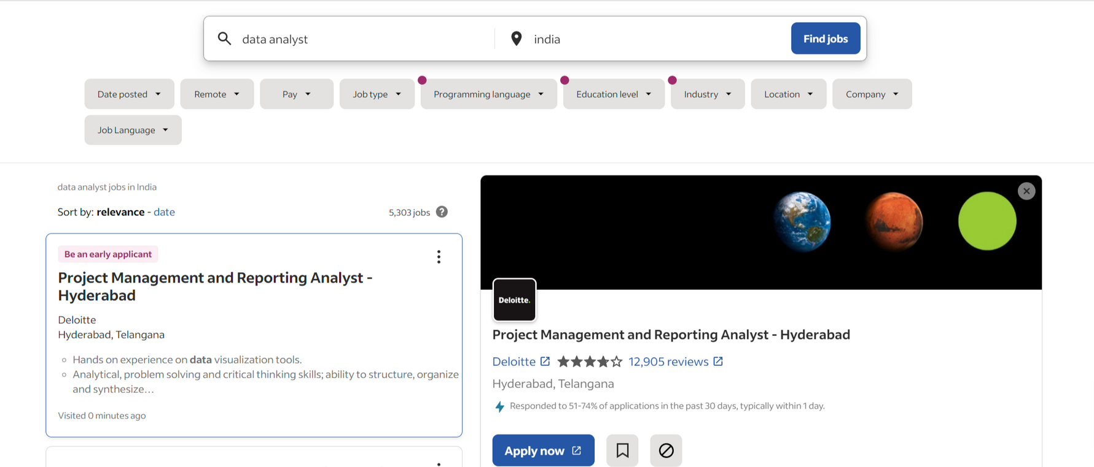
INTRODUCTION
03
The rapid expansion of online job portals and e-recruitment has caused information overload for both job seekers and recruiters, complicating decision-making processes. Additionally, ongoing technological advancements and industry changes are generating new employment prospects that demand a wide range of skills and in some cases, this leads to a misalignment between job seekers and the job market.

Slide 4
BACKGROUND STUDY
04
In order to tackle these problems, there have been numerous developments were introduced in a field of online talent management and one of the notable achievements is the Job Recommendation System.
Over the last decade, the Job Recommendation System has been studied from various perspectives, with numerous research publications suggesting different algorithms, all with the ultimate goal of developing the most effective structure. And most of them were predominantly cantered around Collaborative Filtering, Content-Based Filtering, or a combination of these two.
However, Content-Based Filtering, in particular, has achieved notable success in Job Recommendation Systems due to the nature of this domain. Online talent management relies solely on textual information containing job details for recruiters or personal information for job seekers, making it a direct challenge for Natural Language Processing. Additionally, CBF has proven to be a valuable solution for addressing the cold start problem, which is crucial in JRS. This domain is unique, and the problem-solving strategy differs from traditional recommendation systems because individuals typically do not search for jobs as frequently as they listen to music, watch movies, or purchase products. Job seekers often use job platforms intermittently, and once they are hired, they cannot rank or review the job.

Slide 5
RELATED WORKS
05
After reviewing publications and literature regarding Content-Based Job Recommendation Systems, a few observations were noticed:
There is no general standard for the generation of Job Recommendation Systems.
Regardless of the timeframe of the publication, authors are using a variety of NLP techniques, ranging from traditional to novel.
There is not much comparative evaluation of these different NLP techniques in the field of JRS.
For example, comparisons between TF-IDF and Word2Vec have been made in the context of JRS, yet the outcomes of their effectiveness differ greatly, influenced by the system's architecture and its various components. There are instances where TF-IDF has shown superiority, while in other scenarios, Word2Vec embeddings have been more effective. In some recent studies BERT's was highlighted with its impressive capabilities in numerous tasks on JRS, by leveraging its encoding features. Yet, the direct comparison of these three embedding models—TF-IDF, Word2Vec, and BERT—within the same JRS framework has not been explored. This oversight represents a current gap in the literature, particularly in evaluating the performance of JRSs using the vector representations provided by these techniques.

Slide 6
RESEARCH QUESTION & OBJECTIVES
06
The research aims to address the following research question:
Can the application of Transformer’s encoders, known for their state-of-the-art performance across various NLP tasks, outperform distributed word embeddings or traditional statistical representation methods in improving the accuracy of person-job ranking within job recommendation systems?
To address the research question, the following objectives were formulated:
Objective 1: To conduct a comparative model evaluation experiment among different text representation architectures. The first objective of the study focuses on conducting a thorough comparative analysis through an experiment. This involves using both a validated benchmark dataset from secondary sources and primary collected data. The experiment will deploy the designed architectures to assess their effectiveness in ranking individuals for jobs. The objective is to identify the strengths and weaknesses of the employed methods and how well they perform in real-world situations.
Objective 2: To conduct a comparative human evaluation experiment among different text representation architectures in real-life situations. The secondary objective of the research entails conducting a detailed comparative experiment involving human evaluation. This experiment utilises primary collected data as well as data obtained through web scraping. It involves implementing the created architectures to test their effectiveness in ranking and matching people with jobs under real-world conditions. The objective also includes determining the strengths and drawbacks of the techniques used, as well as evaluating their practical performance in real-life scenarios.
Objective 3: To the best of my knowledge draw conclusions and formulate evidence-based recommendations. The third and final concluding objective of the study is focused on integrating the results of the research. The primary aim here is to draw informed conclusions from the results of the comparative evaluation studies. These conclusions are intended to lay the groundwork for recommendations based on evidence, offering key insights to researchers, practitioners, and decision-makers working within the dynamic landscape of JRS. The overarching purpose of this research is to enrich the field by providing data-driven guidance, enhancing the precision and efficiency of person-job ranking, and contributing to the evolving domain of JRS.

Slide 7
METHODOLOGY
07
The evaluation of the system is the cornerstone of research methodology in Recommendation System, which evolved from experimental practice in Machine Learning and Information Retrieval (Castells and Moffat, 2022). Typically, recommendation systems are assessed using either online or offline methods.
online evaluation: in online assessment, recommendation algorithms and models are evaluated in real-time while actively being used by users in a live or production environment. This approach provides insights into how the system performs under actual usage conditions.
offline evaluation: in contrast, offline experiments utilize pre-existing datasets of users and items. The goal is to closely replicate the data that the system is expected to encounter when deployed online. By analyzing historical data, researchers can assess the system’s effectiveness and make informed improvements.
For this research, a combination of offline and online evaluations was conducted with three experiments to assess and compare text representation techniques in the Job Recommendation System. However, to carry out these evaluations, a framework enabling experimentation was necessary. The decision was made to develop a custom JRS specifically tailored to help obtain answers to the main research question.
JOB RECOMMENDATION SYSTEM ARCHITECHTURE
1. CLASSIFICATION
UNIT
2. RANKING
UNIT
3. RECOMMENDATION
UNIT

Slide 8




DATA COLLECTION
08
Job offers’ dataset
Job seekers’ dataset
644
jobs
146
jobs
376
jobs
user1
user2
user3
nurse
ads
electrician
ads
data analyst
ads
nurse
electrician
data analyst
In total, three experiment volunteers were recruited using a convenience sampling technique. The selection was based on their accessibility and proximity through an online social media platform. Two participants underwent online interviews, while one participant completed a Google Form. All three participants willingly shared relevant information and provided written consent. To adhere to ethical guidelines and prevent bias related to gender, age, or race, any personal information that could identify the participants was removed.
The following information was collected from each participant and is used in the research:
participant’s job role of interest
participant’s educational information
participant’s skills information
participant’s experience information
Web scraping was employed to collect publicly available data related to the Dublin Area from Indeed.com. Using the Python library Selenium, a bot was created to access the website and retrieve job advertisements relevant to each participant. The data collection occurred on two separate occasions, resulting in a total of 1166 unique job advertisements along with their details. To adhere to ethical standards, certain information such as salary, contact details, organization locations, and office addresses was excluded from the job descriptions.
After web scraping the gathered data was organized and stored across five distinct columns, which included:
job title
job ID
job URL
job posting date
job description

Slide 9
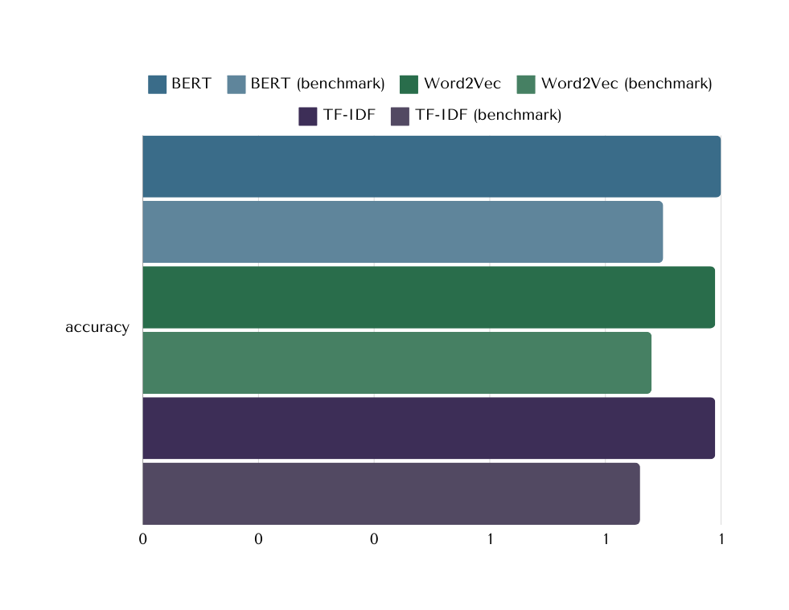
EXPERIMENT 1 (CLASIFICATION)
09
It accesses the quality and determines which of the three text techniques is most appropriate for the classification unit.
CLASSIFICATION UNIT
NEW JOB AD
NEW USER
TEXT REPRESENTATION STAGE
CLASSIFICATION STAGE
(it can be any classification model,
and in this current case: standard LR)
JOB ADS’ POOL
USERS’ POOL
text
label
vectors
text
label
vectors
All three methods exhibited high effectiveness on the primary dataset, with a slight decrease observed in the benchmarking. Among them, the embedding performance of the BERT model achieved the most superior results overall compared to the other two techniques, with BERT(primary) = 1 and BERT(bench) = 0.90. In terms of efficiency and processing speed, TF-IDF distinguished itself with its exceptionally fast processing capability compared to the other methods.

Slide 10
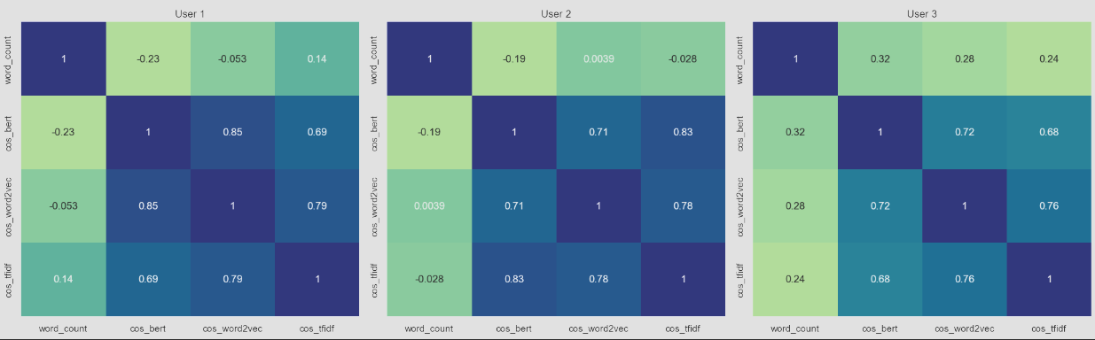
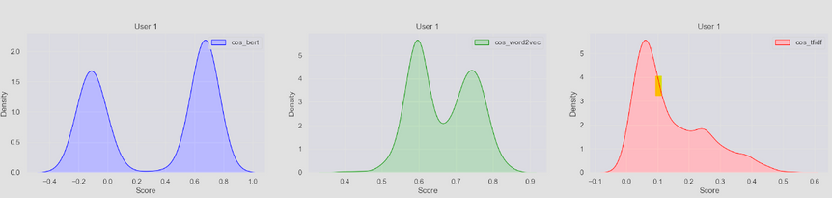
EXPERIMENT 2 (COSINE CALCULATION)
10
It accesses the quality and determines which of the three text techniques is most appropriate for the cosine calculation.
RANKING UNIT
example for: jobs to user A
JOB ADS’ POOL
USER’ POOL
text
label
vectors
text
label
vectors
Summary statistics: the length of the job ads can vary significantly (10-3000); cosine scores with BERT have the widest range (-0.243 to 0.736); Word2Vec has the highest mean similarity score, Word2Vec and TF-IDF have no negative scores and have a low standard deviation compared to BERT cosine scores.
Distribution: BERT scores have bimodal distribution and both peaks situated on both the negative and positive sides. Word2Vec has 1 bimodal and 2 unimodal distributions and peaks clustering 0.6-0.8, TF-IDF has right-skewed pattern with outliers with high values.
Correlation: neither a high nor a moderate correlation exists between the word counts of a text and the cosine similarity scores for all users, high correlation is observed among the cosine scores generated by the three techniques.
Kruskal-Wallis test: p = 3.76 and the statistics = 1314.43 suggests that a statistically significant difference exists in the median cosine similarity scores derived from comparing document pairs through various text embedding techniques.
Cliff's Delta test: BERT – TF-IDF = 0.1057, BERT – Word2Vec = (-0.4331), Word2Vec – TF-IDF = 0.9998; substantial discrepancy exists in cosine calculation score between Word2Vec and TF-IDF, with a moderate difference observed between BERT and Word2Vec models.
COSINE SIMILARITY CALCULATION STAGE
RANKING STAGE
RANKED JOB LIST
USER A
with same label as user A
ranked by ascending order
ready for selection
with label B
ready for recommendation

Slide 11
EXPERIMENT 3 (RANKING & HUMAN EVALUATION)
11
First incorrect label occurrence index and correct ranking order percentage:
user1=644 jobs BERT = 644 (100%) Word2Vec = 535(95.81%) TF-IDF = 433 (89.29%)
user2=146 jobs BERT = 144 (99.32%) Word2Vec = 71(82.88%) TF-IDF = 66 (89.73%)
user3=376 jobs BERT = 373 (99.73%) Word2Vec = 103(77.39%) TF-IDF = 55 (86.70%),
BERT consistently outperformed Word2Vec and TF-IDF in ranking order; the lowest score can be seen with Word2Vec; while TF-IDF exhibits stability, although its accuracy is lower compared to BERT.
Human evaluation matches:
user1=30 BERT = 23(76.67%) Word2Vec = 18(60%) TF-IDF = 14 (47%)
user2=30 BERT = 23(76.67%) Word2Vec = 18(60%) TF-IDF = 21 (70%)
user3=30 BERT = 26(86.67%) Word2Vec = 19(63.33%) TF-IDF = 24 (80%)
BERT recommendations were more closely aligned with human ranking; the lowest mismatch can be observed with TF-IDF; Word2Vec scores the lowest, ranging around 60%.
Shapiro-Wilk test (of all samples): The result showed that none of the samples follow a normal distribution.
Spearman’s Rank Correlation (model ranking vs human ranking):
user1 BERT = 0.826 Word2Vec = 0.762 TF-IDF = 0.601
user2 BERT = 0.850 Word2Vec = 0.780 TF-IDF = 0.700
user3 BERT = 0.905 Word2Vec = 0.696 TF-IDF = 0.863
BERT showed correlations higher than 0.7 in all three instances, with very low p-values. This indicates a strong positive association between the model ranking and human ranking, and there is a very low probability that this strong association is due to chance; Word2Vec and TF-IDF, each showed moderate correlations in one instance, also with very low p-values, which is acceptable.
RECOMMENDATION UNIT
example for: jobs to user A
RANKED JOB LIST
USER A
with same label as user A
ranked by ascending order
ready for selection
with label B
ready for recommendation
STAGE FOR APPLYING
CONDITIONS TO THE RANKED
JOB LIST
RECOMMENDATION JOB LIST
list of ranked jobs
for a given condition
jobs can be selected randomly
Wilcoxon Signed-Rank Test (model ranking vs human ranking):
user1 BERT = 0.705 Word2Vec = 0.083 TF-IDF = 0.04
user2 BERT = 0.058 Word2Vec = 0.004 TF-IDF = 1
user3 BERT = 0.317 Word2Vec = 0.285 TF-IDF = 0.102
With BERT, no statistical significance was observed. However, Word2Vec and TF-IDF showed statistical significance in one instance each.

Slide 12
CONCLUTION
12
The BERT model, with its advanced encoding capabilities, emerged as the most reliable technique for accurately classifying job advertisements and closely mirroring human evaluations in job recommendations. Its superior performance in embedding semantic similarity between job ads and user profiles underscores the importance of employing sophisticated NLP models to enhance the efficacy of content-based recommendation systems.
Word2Vec, notable for its embedding efficiency, showed commendable performance, particularly in representing job ads in a semantically meaningful space. However, its variability across different user evaluations indicates that while it is a valuable tool for capturing semantic relationships, it may not consistently align with individual user preferences.
The TF-IDF with BoW approach, despite being outperformed by the BERT model in terms of alignment with human evaluations, demonstrated its utility in efficiently processing and classifying job ads. Its rapid execution time and simplicity make it a viable option for initial filtering processes within the JRS framework.

Slide 13

REFERENCES
13

Slide 14




thank you for your attention

